Slide 1

Tiktok Trends Analysis
Group 1
By: Kenny Duong, Erick Gomez, Karina Gonzalez, Jammal Loiseau, Javier Machuca

Slide 2
Abstract
Outlines the approach for collecting data on TikTok, and what songs are most popular on viral videos
Trending songs used
Excel is utilized to organize the data scraped from TikTok giving us a better understanding of how viral videos connect to the songs implemented.
Lastly, we will use Tableau for the visual representation of our dataset.

Slide 3
Introduction
We chose this dataset because of the popularity surrounding TikTok.
We downloaded a dataset with a list of viral videos and we wanted to see what songs on the dataset were most used, thus being most popular.
Our dataset consisted of categories such as artist, song name, album name, disc number, title name, released date, record label, video length, source of the music and platform (Spotify & Apple Music)
This dataset helped us draw the conclusion that popular songs help boost video views and make them go viral.

Slide 4
Related Work
There were similar works that showed popular music used in TikTok
MBW (Music Business Insider World)
Revealed there are more MAUS (monthly active users) compared to before
MRC study shows that majority of TikTok users use the app to share new artists and aid in discoverability
Also found users of TikTok more likely seek out songs if heard while using the app.
Supports our initial hypothesis that music helps in making a TikTok video trend.

Slide 5
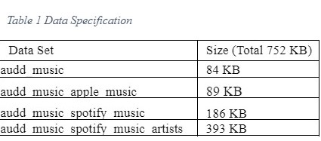

Specifications
The dataset spans several files and contains data scrapped of trending videos from 2020.
Table 1 contains files and their size.
Table 2 shows the specification for Oracle cluster we are using and Hadoop specification for our project.

Slide 6
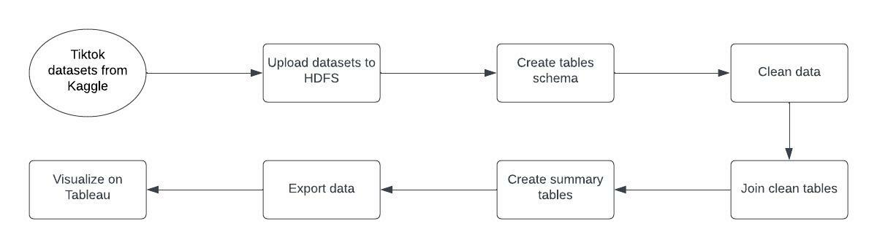
Implementation Flowchart
Dataset is composed of various different songs used and respective ID numbers
Whole process of downloading the dataset is outlined below
Dataset contains four files each focusing on different sources of music. (Spotify and Apple Music, etc.)
HiveQL was used to create a summary table listing the top trending videos

Slide 7
Data Cleaning
The files were uploaded and stored in HDFS and then loaded into tables using Hadoop Beeline client.
The dataset required minimal cleaning overall because scrapped data was mostly organized
The data was separated according to different music sources (spotify and apple music).
The Spotify artists and Spotify music was combined for a more comprehensive dataset.
However, few values were missing (ID number) and were removed in the final output

Slide 8
Analysis
Once the data was prepared we completed the analysis by loading it into Hive.
We found that Billie Eilish and LP the Rapper appeared the most often at 14 and 13 times respectively.
Billie Eilish - Therefore I Am, Billie Eilish - Bad Guy
LP The Rapper - LMSS
This allowed us to draw the conclusion that certain artists are more likely to contribute to virality of a video on TikTok.

Slide 9
Conclusion
Wide array of artists/songs contribute to an viral video
Some songs have more staying power than others
A few artists have multiple songs that went viral
(Multiple times in most cases)
Over half of songs that went viral were released in last 5 years
(2017-2022)
Pop and Rap genre of music had most counts of viral videos (based on data).

Slide 10
References
Stassen, M. (2021, July 21). 75% of TikTok’s users say they discover new artists on the platform. Music Business Worldwide. https://www.musicbusinessworldwide.com/tiktok-has-over-800m-active-users-worldwide-75-of-them-say-they-discover-new-artists-on-the-platform/
https://github.com/JamBaby23/TikTok
https://github.com/JamBaby23/TikTok/raw/main/audd_music.csv
https://github.com/JamBaby23/TikTok/raw/main/audd_music_apple_music.csv
https://github.com/JamBaby23/TikTok/raw/main/audd_music_spotify_music.csv
https://github.com/JamBaby23/TikTok/raw/main/audd_music_spotify_music_artists.csv

